Slide 1
Session 37
Preparation for the Second Advent

Slide 2
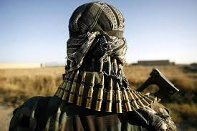
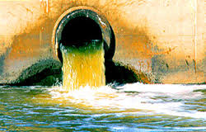
400 Years

Slide 3
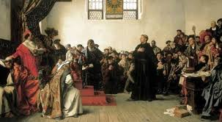
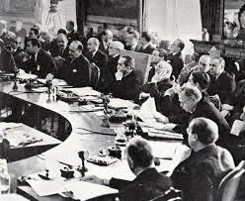
Preparation for the Second Advent: 400 years (1517-1918)
1517
Reformation
End of World War I League of Nations
1918

Slide 4
The purpose of history is to receive the Messiah.
True love
Abel
Wants to change
Separation from Satan
Cain
Selfish love

Slide 5
Divide good and evil, and naturally win over evil
Jesus
Moses
Abraham
Abel
Chosen to sacrifice
Cain
Pagan tribes
Oppressors

Slide 6
Internal and external traits and motives
Internal:
religion, ideology, worldview
Hebraism: Judaism, Israel
Abel-type
Abel
Cain
Cain-type
Hellenism: Greco-Roman world
External:
economy, government

Slide 7
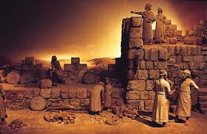
Hebraism centering
on Judaism
Second Temple
Mosaic Law
Ezra, Nehemiah, Malachi
Jewish Scriptures
Reformation
Foundation of faith
Messianic expectation
Jesus appeared

Slide 8
Axial age: global spiritual preparation
Buddha
Socrates
Zoroaster
Confucius
Jesus

Slide 9
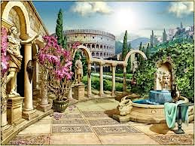
Cultural sphere
Language
Economy
Legal system
Pax Romana
So Jesus could reach the world

Slide 10
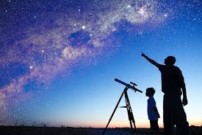
Environment for Jesus’ return
Internal: Reformation
Protestant reform
Spiritual development
Abel-type
Cain-type
External:
Renaissance
Science
Politics
Catholic renewal
Social development
Economics
Religion

Slide 11
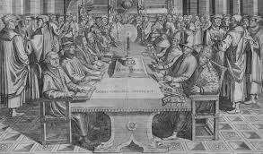
How did the Protestants prevail?
Leo X sold indulgences to build St. Peter’s
Lutheran spirit and German nationalism
Zwingli, Calvin build international movement
30-Years War—Protestant vs Catholic
Westphalia, 1648: the king decides the religion

Slide 12
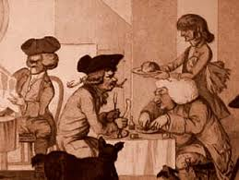
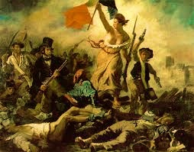
Enlightenment turns against religion
Reason and experience separate nature & man from God
Descartes: Rationalism, Bacon: Empiricism
Hume, Hobbes, Locke, Spinoza
Voltaire, Diderot, D'Alembert: anti- Church, pro-revolution
Brotherhood, freedom and equality → end monarchy
Cain-type democracy → atheism and dictatorship

Slide 13
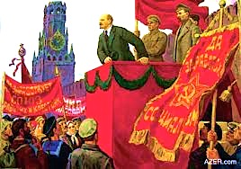
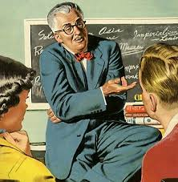
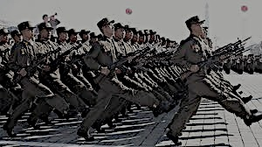
The emergence of left-wing thought
Hegel’s idealism upended into dialectical materialism
Communism: the dictatorship of the party
Miracles are false, religion is a social construct
Class struggle, violence leads to ideal society
Democratic people’s republics

Slide 14
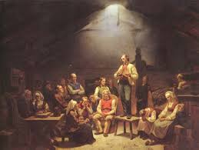
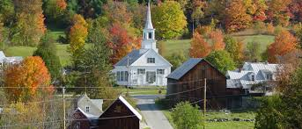
The Reformation’s legacy grew strong
Direct experience of God over external form of religion
Puritans flee persecution to build godly society
American revolution founded on Christian principles
Freedom of faith → freedom of politics and economy

Slide 15
The Reformation’s legacy grew strong
Pietism—conservative politics, mystical experience
Baptists died for religious freedom
Wesley founded Methodist societies
Quakers—oneness with Christ
Swedenborg’s teachings on spirit world

Slide 16
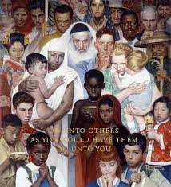
First and Second World Wars
Longing for God’s nation
Abel: Allies Freedom of religion
Cain: Axis
No freedom of religion
Reformation through force

Slide 17
Everlasting purpose
Global democracy, freedom of religion
Global exchange, communication, transportation
Purpose to expand the reach of Second Advent
A Parent’s heart to prepare for a new birth

Slide 18
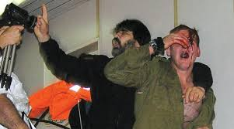
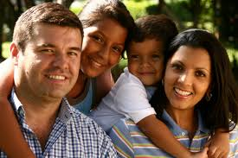
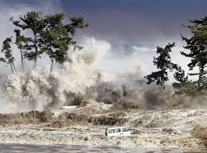
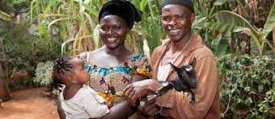
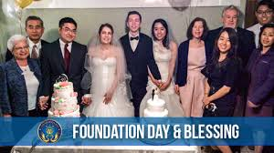
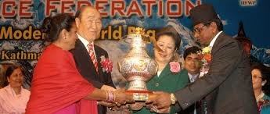
The last days—end of history

